Slide 3

AIMS: An Internet Media Store
IT4549E - ITSS Software Development
Instructor: Ph.D. Nguyen Thi Thu Trang

Slide 4
INTRODUCTION
1. Scope
The AIMS Project is a desktop e-commerce software designed to facilitate the selling of media products such as books, LP records, CDs, and DVDs.
Guests: Search and purchase necessary items
Administrators: manage users
Product managers: manage and make changes to product and order

Slide 5
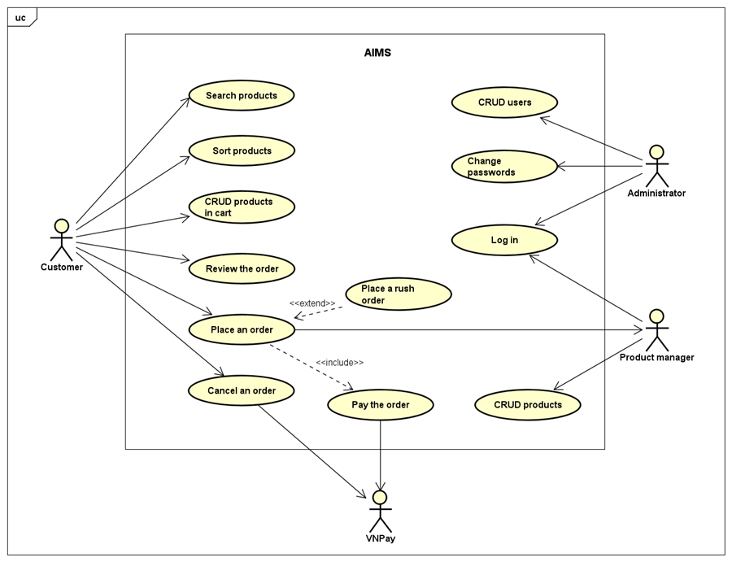
OVERALL DESCRIPTION
General Overview

Slide 6
OVERALL DESCRIPTION
2. Assumptions/Constraints/Risks
Assumptions
- Stable Hardware Environment
Utilizes specified operating systems
- User Proficiency
End-users have basic technical skills
- Functionality Changes
Future changes will be minimal and manageable
- Software Integration
Assumes compatibility and availability of related software components

Slide 7
OVERALL DESCRIPTION
2. Assumptions/Constraints/Risks
b. Assumptions
- Hardware Limitations
- User Environment
- Resource Availability
- Data Repository
c. Risks
- Security Risks: Mitigated by encryption and authentication
- Resource Limitations: Addressed through efficient coding and optimization

Slide 8
SYSTEM ARCHITECTURE & ARCHITECTURE DESIGN
1. Architectural Patterns
Pattern Overview:
Entities: Core business logic and data, reusable and independent. Examples: Account, Customer, Transaction.
Controls: Coordinate interactions between entities and boundaries, manage use cases. Example: PlaceOrder control.
Boundaries: Interfaces for external interactions (UI components, APIs).
Advantages:
Separation of Concerns: Modular and easier to understand.
Maintainability: Isolated changes reduce risk.
Scalability: Add features without altering existing entities.
Testability: Independent testing of business logic and interfaces.

Slide 9
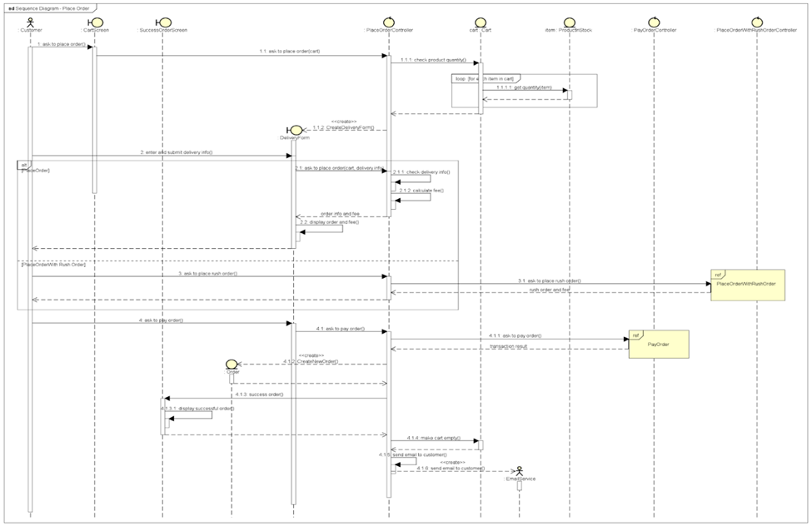
SYSTEM ARCHITECTURE & ARCHITECTURE DESIGN
2. Interaction Diagram:
Place order

Slide 10
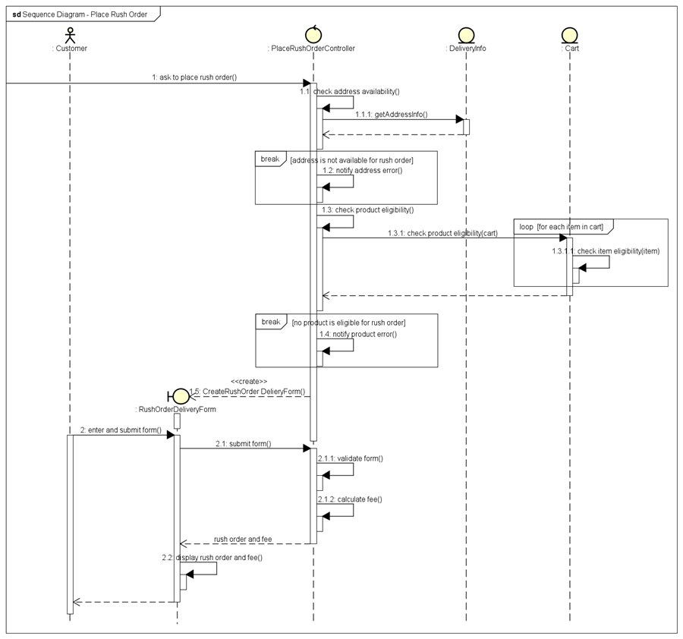
SYSTEM ARCHITECTURE & ARCHITECTURE DESIGN
b) Place rush order

Slide 11
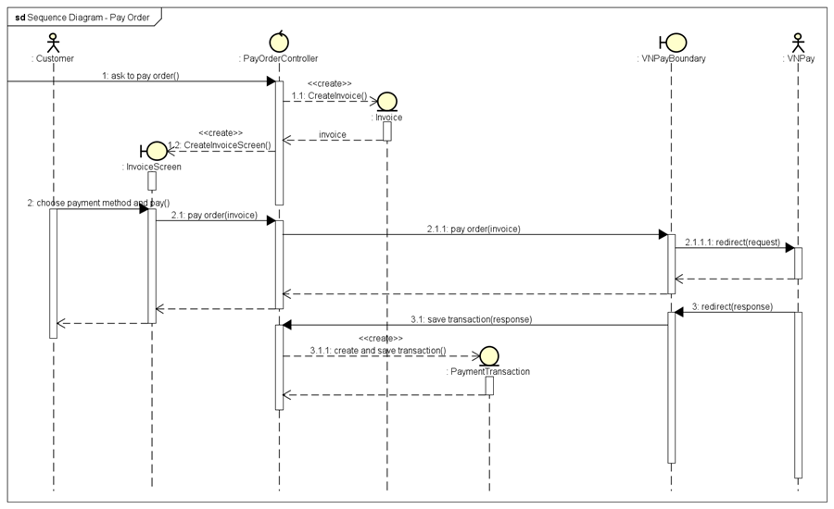
SYSTEM ARCHITECTURE & ARCHITECTURE DESIGN
c) Pay order

Slide 12
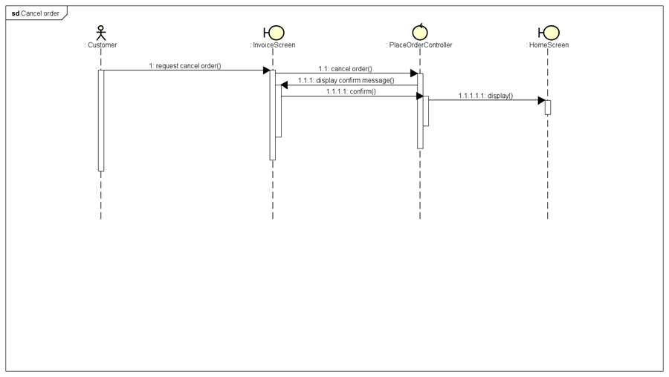
SYSTEM ARCHITECTURE & ARCHITECTURE DESIGN
d) Cancel order

Slide 13
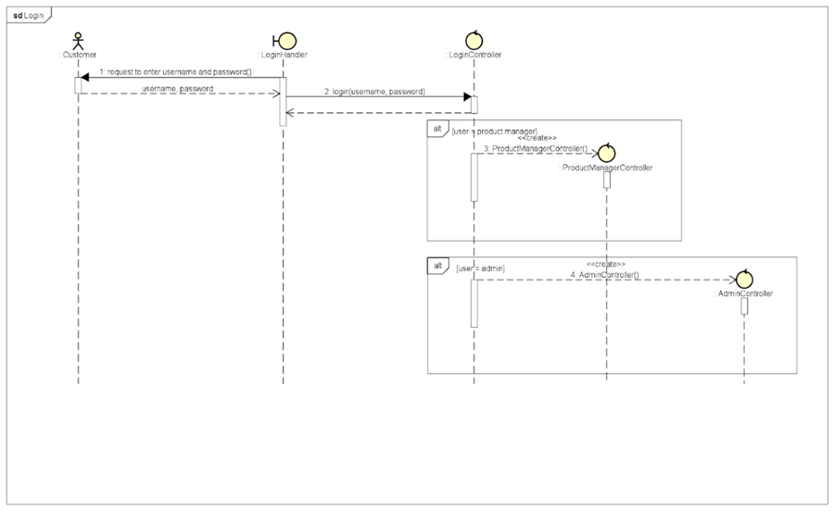
SYSTEM ARCHITECTURE & ARCHITECTURE DESIGN
e) Login

Slide 14
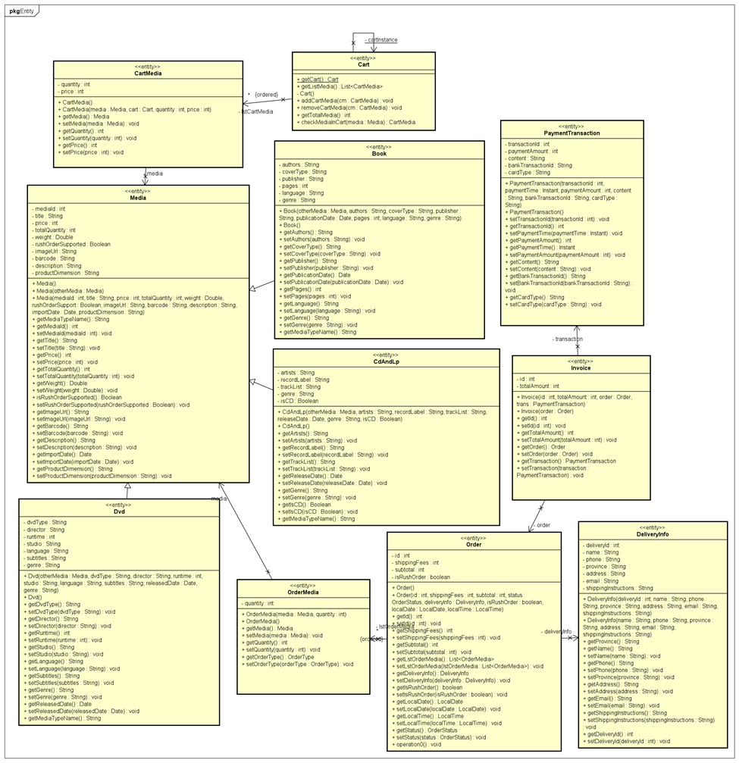
SYSTEM ARCHITECTURE & ARCHITECTURE DESIGN
3. Analysis Class Diagram
Package Entity

Slide 15
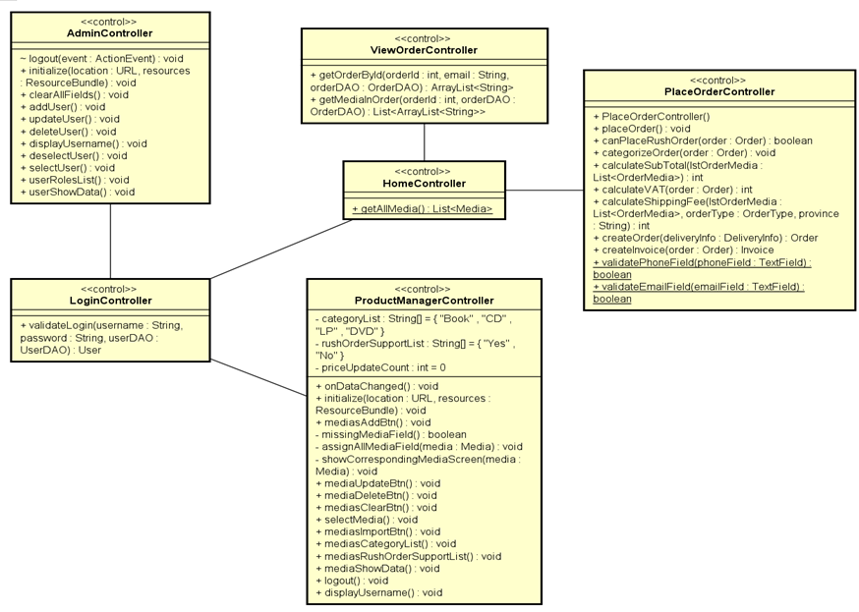
SYSTEM ARCHITECTURE & ARCHITECTURE DESIGN
b) Package Controller

Slide 16
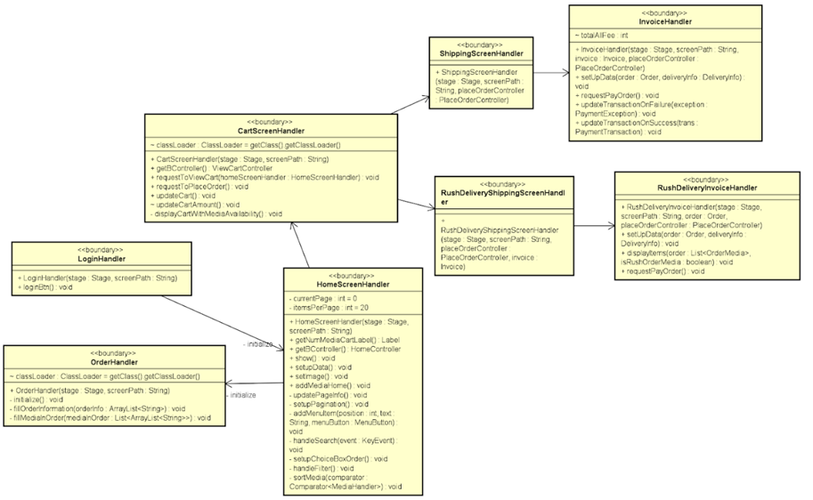
SYSTEM ARCHITECTURE & ARCHITECTURE DESIGN
c) Package Boundary

Slide 17
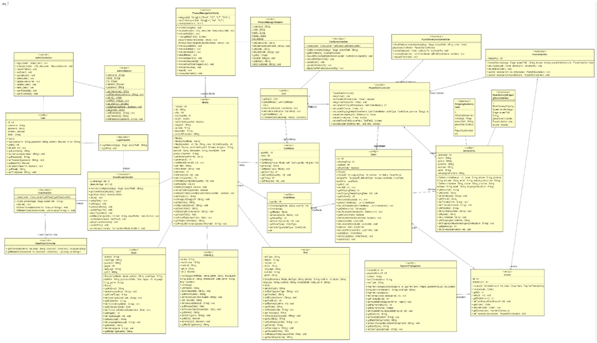
SYSTEM ARCHITECTURE & ARCHITECTURE DESIGN
4. Unified Analysis Class Diagram

Slide 18
DETAILED DESIGN
User interface design
There are screens in our AIMS software: Cart Screen, Delivery Forms, Login Form, Admin Dashboard, Product Manager Dashboard, …
Display: resolution 1366x768.
Consistency of expressions: comma-separated for numbers, a limited range of valid characters for strings ([0-9],. _-)
Control: input format checking functionality included; no stack frames, each screen is separated.
Error: error message with its details displayed while encountering such one.

Slide 19
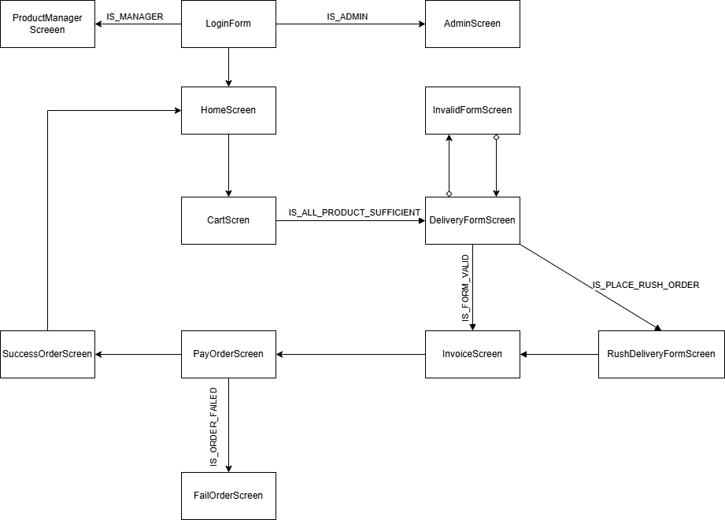
DETAILED DESIGN: SCREEN TRANSITION DIAGRAM

Slide 20
DETAILED DESIGN
2. Data Modelling
Relational database management system: MySQL
Perks: High reliability, scalable, robust, secured.
Index: index created to support rapid search on database.

Slide 21
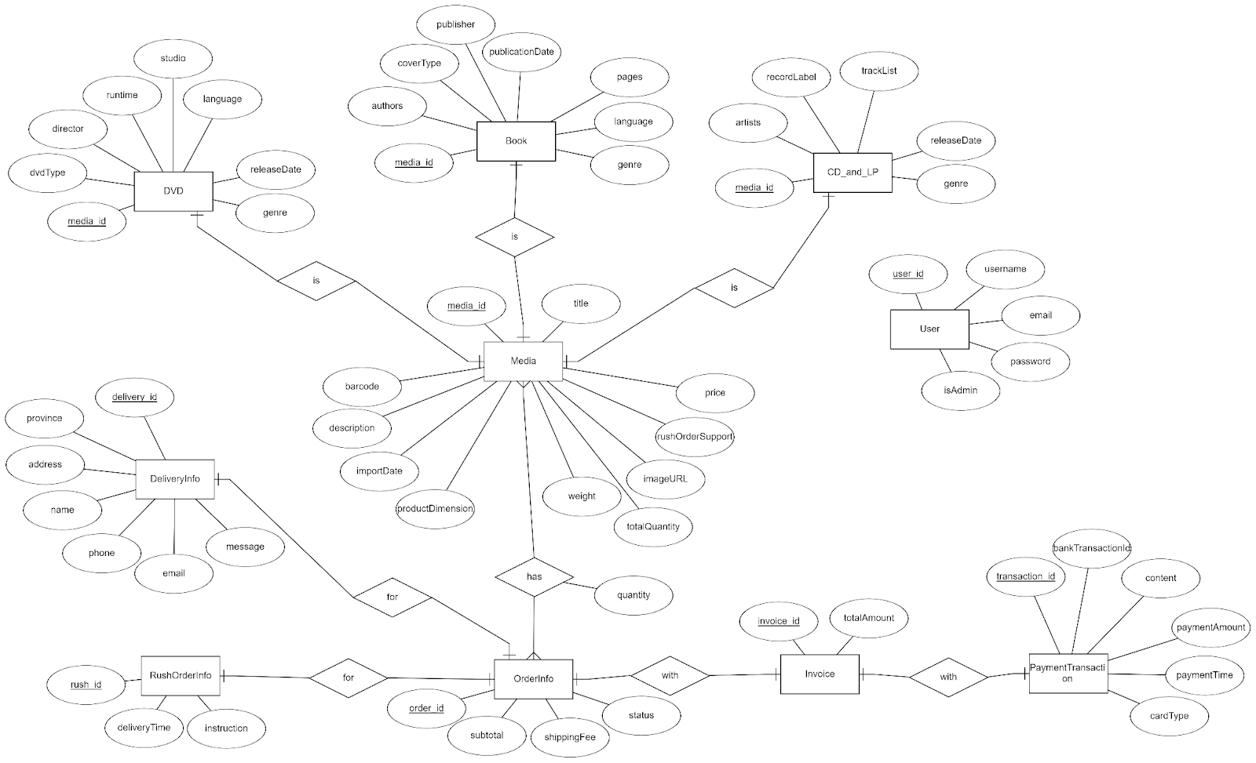
DETAILED DESIGN: ENTITY RELATIONSHIP DIAGRAM

Slide 22
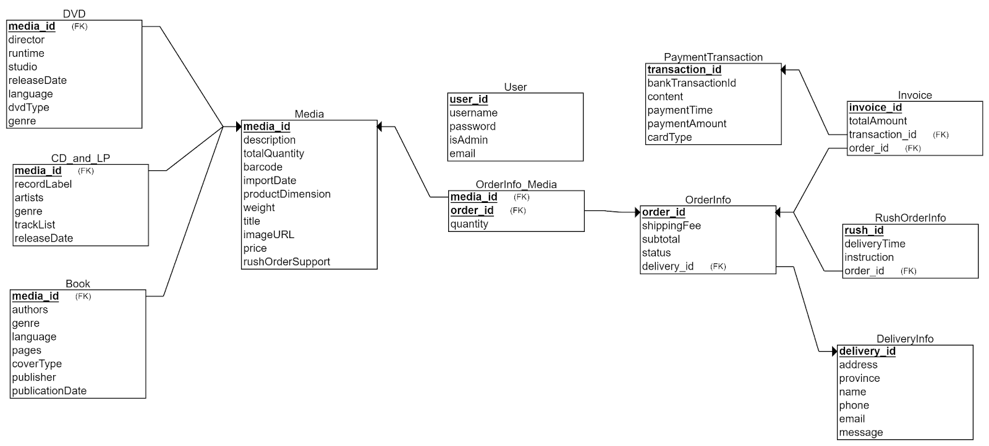
DETAILED DESIGN: DATABASE SCHEMA

Slide 23
DETAILED DESIGN
3. Class design: there are 7 main packages:
Persistence: 2 sub-packages: DAO(data accessible object) and database, which is responsible for storing, retrieving data from and executing operations on database.
Entity: this package includes necessary entities which interact with the system.
View: includes all screen handlers.
Controller: all controllers are packaged here (PlaceOrderController, ...)
Exception: packages all exceptions which can be encountered during execution.
Utils: extended utility classes which support detailed development (error message displayed, screen configuration paths,…)
Subsystem: 2 sub-packages email, payment, which represent email subsystem and VNPay payment subsystem respectively.

Slide 24
DETAILED DESIGN
4. Class design for subsystems
Email: This subsystem is responsible for e-mail transmissions during the execution of the system.
Payment: Payment subsystem injects VNPay payment gateway to streamline checkout process.

Slide 25
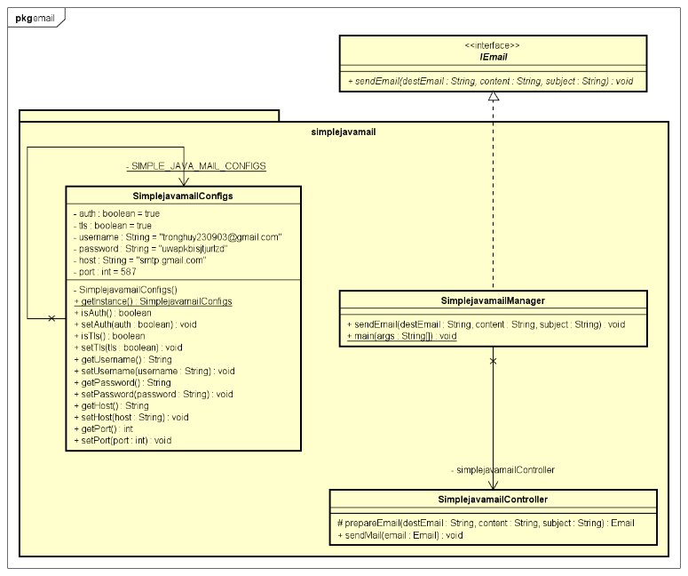
DETAILED DESIGN: CLASS DIAGRAM FOR EMAIL SUBSYSTEM

Slide 26
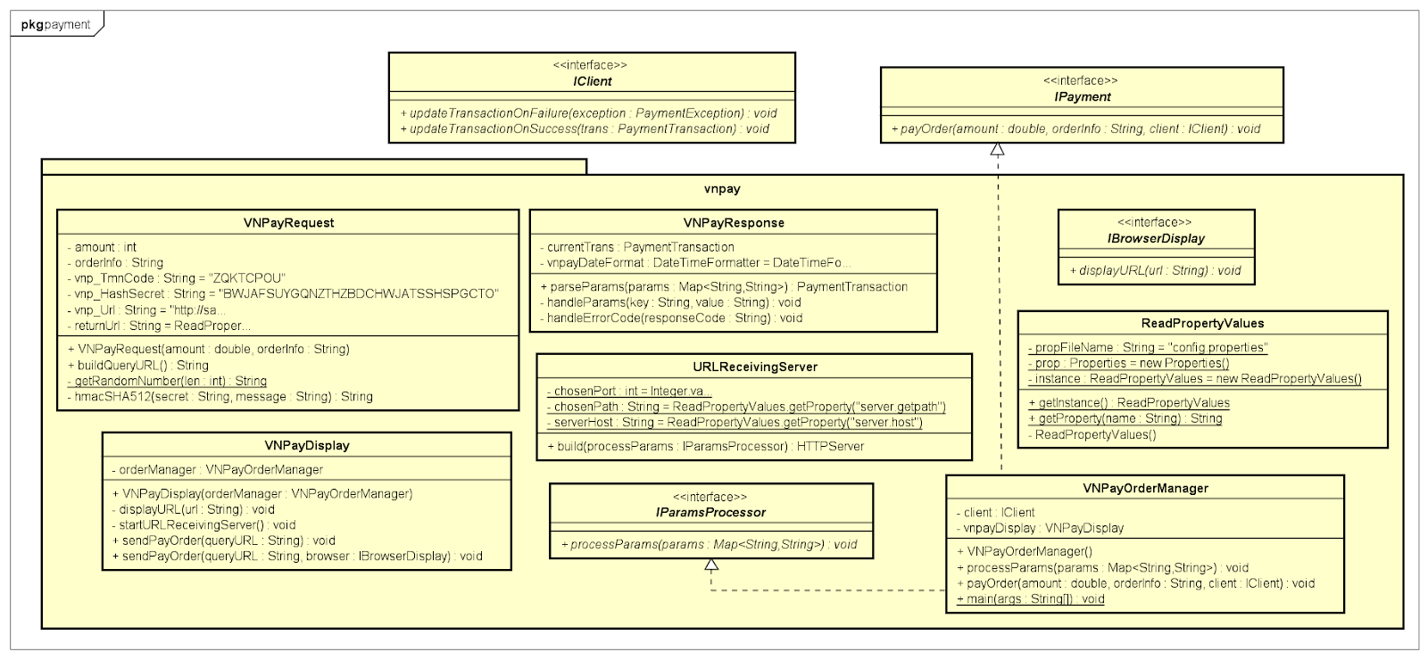
DETAILED DESIGN: CLASS DIAGRAM FOR PAYMENT SUBSYSTEM

Slide 27
DESIGN CONSIDERATIONS
Goals and guidelines
a) Goals
Performance Optimization: Fast, responsive interactions with efficient queries, caching, and minimized data processing overhead.
Scalability: Modular design, scalable technologies (e.g., MySQL), and expandable cloud infrastructure.
Security and Privacy: Strong encryption, robust authentication, and comprehensive logging to protect user data.
User-Friendly Interface: Intuitive, consistent UI for easy navigation and improved user satisfaction.

Slide 28
DESIGN CONSIDERATIONS
Goals and guidelines
b) Guidelines
Coding Standards: Adherence to guidelines for quality and readability, including naming conventions, code formatting, and documentation.
Modular Design: Discrete, self-contained modules for easier management, testing, and updates.
Error Handling: Robust mechanisms for graceful recovery, diagnostic logging, and user-friendly error messages.

Slide 29
DESIGN CONSIDERATIONS
2. Architectural strategies
Programming Language and Frameworks: JavaFX(GUI), Maven.
Database Management System: MySQL.
UI paradigms: follows Rich Client Application paradigm using JavaFX.
Error handling: try-catch blocks are added to ensure internal error does not cause the whole program to collapse.
Testing: JUnit.
Version control: GitHub's "Feature/Release" workflow.

Slide 30
DESIGN CONSIDERATIONS
3. Coupling and Cohesion
Coupling
Modular Architecture: Distinct modules for UI (JavaFX), backend (Java), and data persistence (MySQL) minimize interdependencies.
Interfaces and Abstraction: Components interact through defined interfaces and abstract classes, reducing direct dependencies (e.g., DAOs using Hibernate).

Slide 31
DESIGN CONSIDERATIONS
3. Coupling and Cohesion
b) Cohesion
Single Responsibility Principle: Classes/methods focus on a single task (e.g., UI controllers handle interactions, service classes handle business logic).
Well-defined Modules: Clear purpose for each module (data handling, business logic, UI management) ensures self-contained, cohesive components.
Consistent Design Patterns: Use of patterns like Entity-Boundary-Controller (EBC) promotes high cohesion.

Slide 32
DESIGN CONSIDERATIONS
4. Design patterns
Singleton design pattern
Ensures a class has a single instance and provides a global access point to that instance.
Useful for coordinating system-wide actions (logging, db connections, etc..).
Reduces memory overhead, avoid conflicts from multiple instances.
Promotes consistent access.
Simplifies debugging and maintenance by centralizing control logic.

Slide 33
DESIGN CONSIDERATIONS
4. Design patterns
Singleton design pattern
Ensures a class has a single instance and provides a global access point to that instance.
Useful for coordinating system-wide actions (logging, db connections, etc..).
Reduces memory overhead, avoid conflicts from multiple instances.
Promotes consistent access.
Simplifies debugging and maintenance by centralizing control logic.

Slide 34
DESIGN CONSIDERATIONS
4. Design patterns
Singleton design pattern
Ensures a class has a single instance and provides a global access point to that instance.
Useful for coordinating system-wide actions (logging, db connections, etc..).
Reduces memory overhead, avoid conflicts from multiple instances.
Promotes consistent access.
Simplifies debugging and maintenance by centralizing control logic.

Slide 35
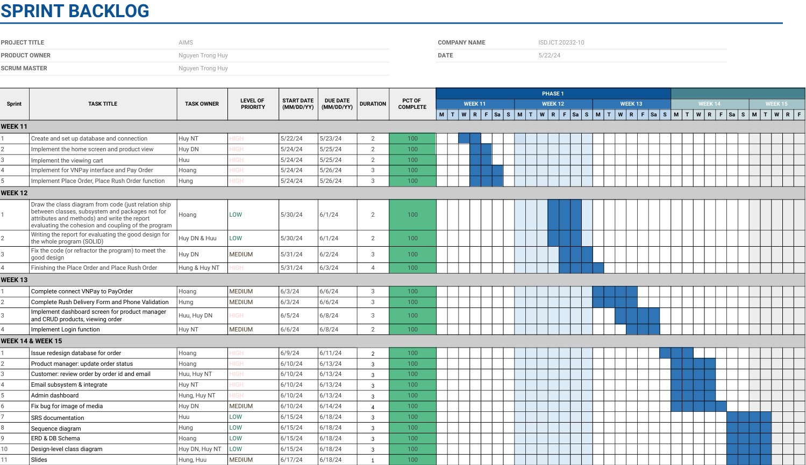
SPRINT BACKLOG & TEAM CONTRIBUTION

Slide 36
THANK YOU !

